Slide 1
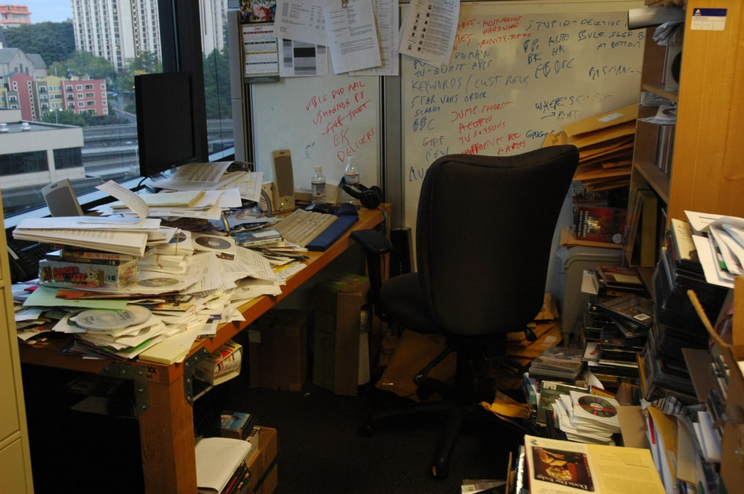
File Management

Slide 2


File-Based Organization
Project-Based Organization
proposal
Masters_ch1_land_cover_change
dmp
consent forms
data
documentation
raw data
Images raw
surveys
Surveys raw
clean data
focus groups
Images cln
Surveys cln
metadata
images
analyses
ch1
intermediate output
ch2
final outputs
manuscript
data archiving
Notes:
There aren't really "rules" about how to organize your files, but I think the best way to organize is to think in terms of "projects". Of course, how you define a "project" is sometimes tough...is the PhD the 'Project' or is each chapter of the dissertation a 'Project'? You'll have to give this some thought and think of a system that works for you. For instance, you could organize as follows, based on file types:

Slide 3

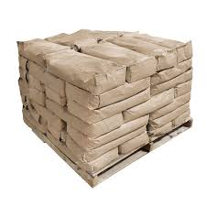
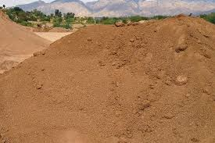

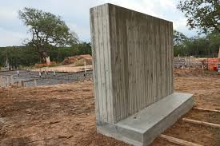
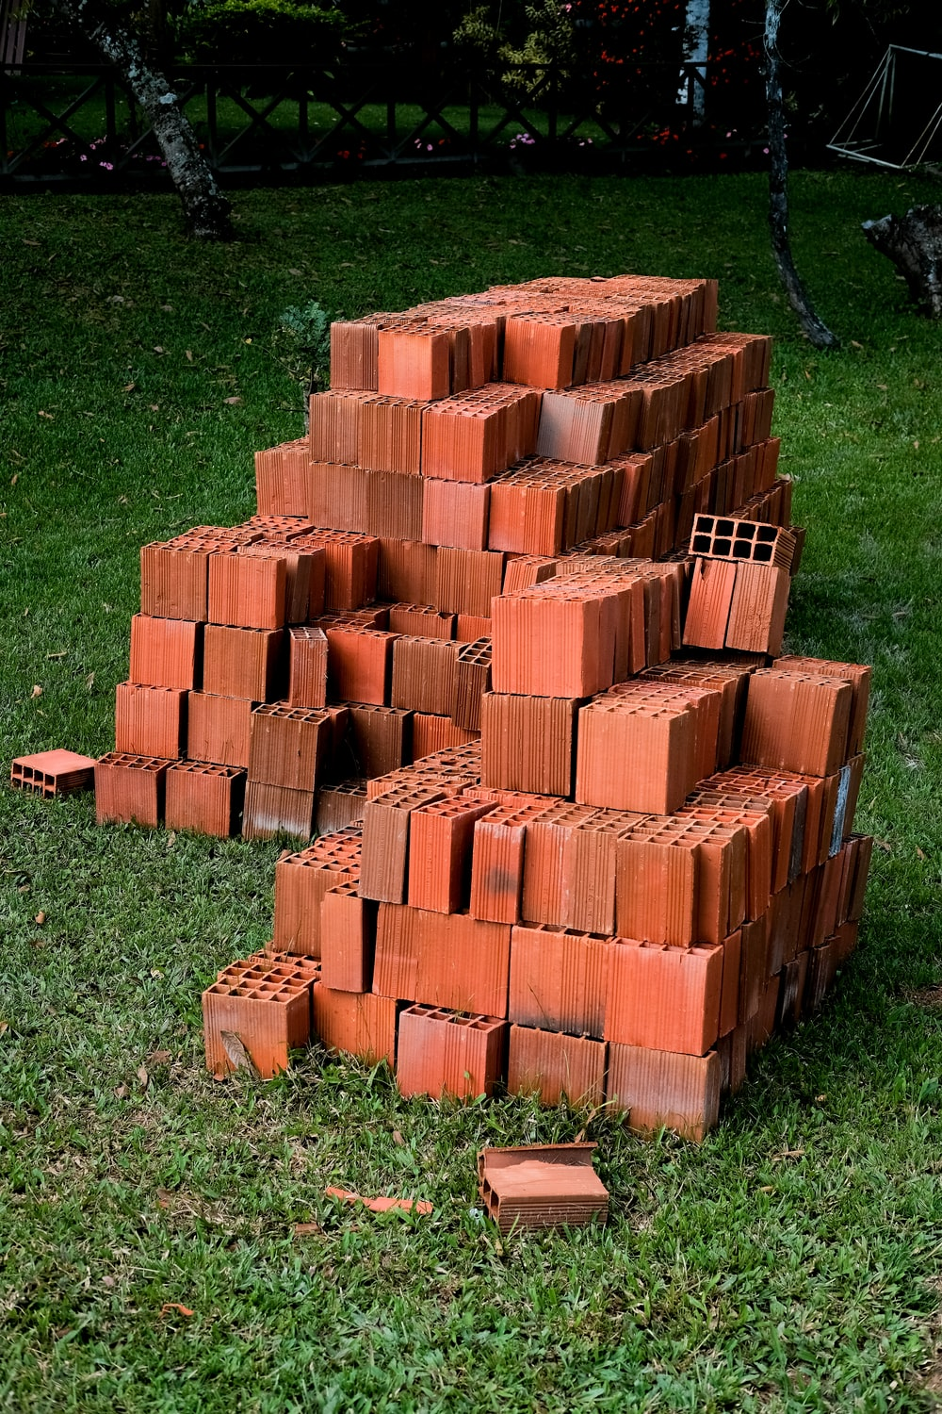



Project-Based Organization
Projects
Masters_ch1_land_cover_change
dmp
data
raw data
Images raw
Surveys raw
clean data
Images cln
Surveys cln
metadata
analyses
intermediate output
final outputs
manuscript
data archiving
Products
Notes:
I like 'Project' based organization for two main reasons. **First**, it pushes you to think as 'projects' leading to of 'products' (e.g., paper, report, grant proposal), and therefore how and where data you are collecting fit in. If trhe data aren't for a new project, and it';'s not clear to you if the data fit into an existing project, then are you sure you need to spend time, effort, and money collecting it? **Second**, project-based organization focuses on the individual steps and components that take a project from start-to-finish: planning your data collection, data gathering and clean-up, analysis, presentation, and data archiving.

Slide 4
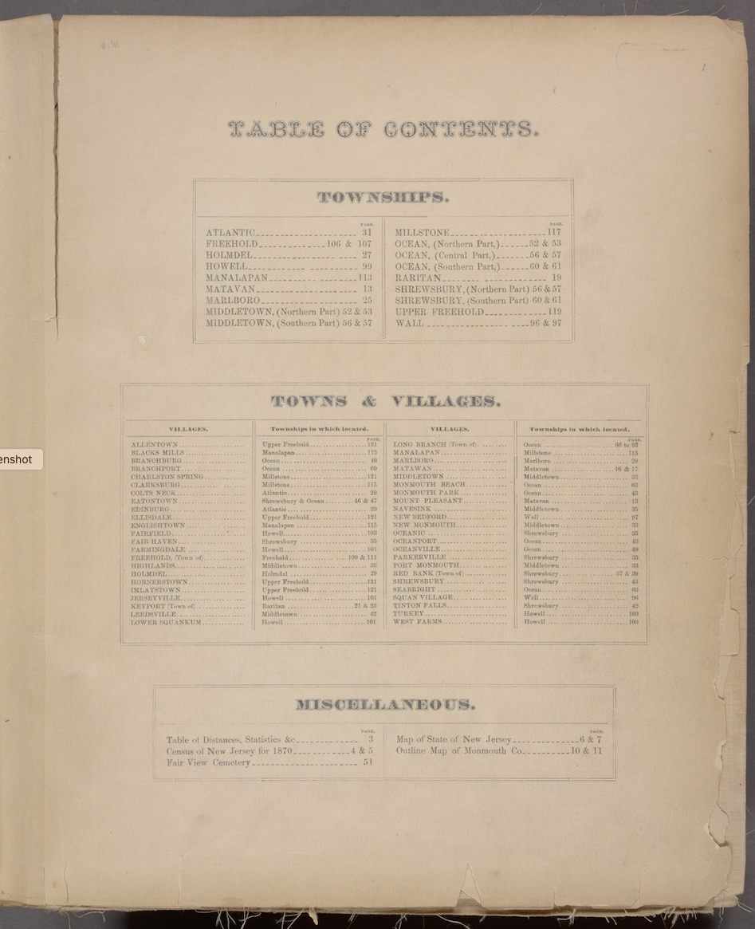
Plan & Document
README.txt
Notes:
1. Prepare a file documenting your data organization structure so you can share it with team members (or look at it years later when looking for something). These can be `'readme'` files as needed for each folder. The `'readme'` file might include such things as explanations of naming conventions and how the structure of the directory relates to the structure of the project.
2. Use appropriate tools, such as version control tools, to keep track of the history of the data files (more on this later in the semester).

Slide 5

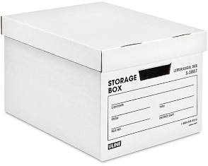
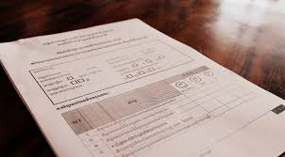
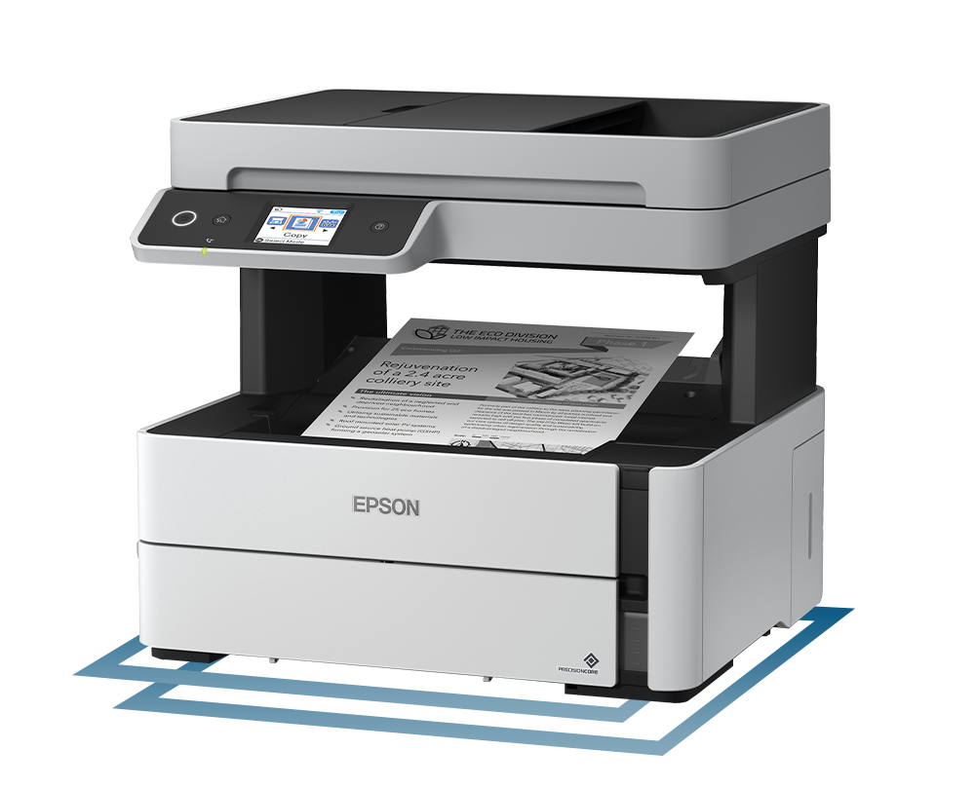



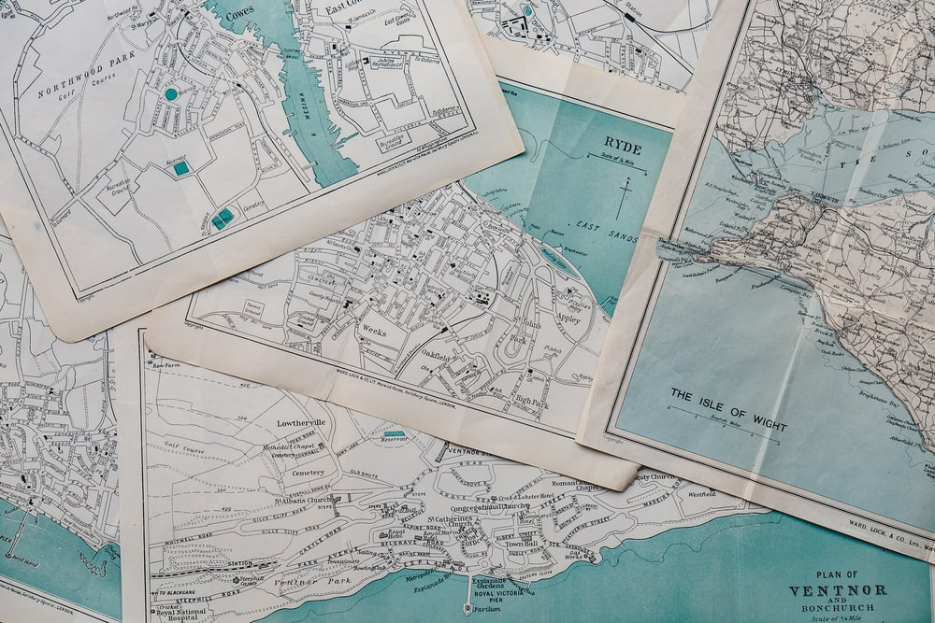

Organization of Physical Files

Slide 6

Masters_ch1_land_cover_change
Masters_ch2_farmer_attitudes
dmp
dmp
data
data
raw data
Procedures for downloading
data from data repository or reading from
the hard drive folder for Ch1
Images raw
Surveys raw
clean data
Images cln
analyses
Surveys cln
intermediate output
metadata
final outputs
analyses
intermediate output
manuscript
data archiving
final outputs
manuscript
data archiving
Notes:
I like 'Project' based organization for two main reasons. **First**, it pushes you to think as 'projects' leading to of 'products' (e.g., paper, report, grant proposal), and therefore how and where data you are collecting fit in. If trhe data aren't for a new project, and it';'s not clear to you if the data fit into an existing project, then are you sure you need to spend time, effort, and money collecting it? **Second**, project-based organization focuses on the individual steps and components that take a project from start-to-finish: planning your data collection, data gathering and clean-up, analysis, presentation, and data archiving.

